Slide 1
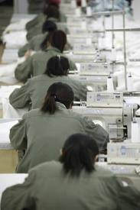
5w’s: what is actually going on?
ANSWER!!!!!!
A SWEATSHOP PRODUCING CLOTHES IN VIETNAM.

Slide 2
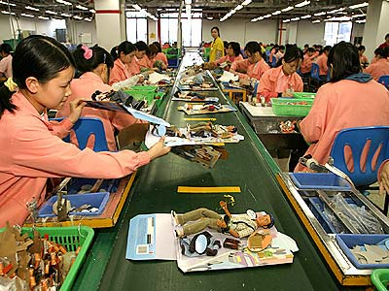
What do you think to working here?
A sweatshop producing toys in China.

Slide 3
The paper bag game
You will replicate a sweatshop by completing the following game.
The first rule is to follow every word of your teacher. Any breaking of rules will result in severe consequences.
You will be placed into groups by your teacher.

Slide 4
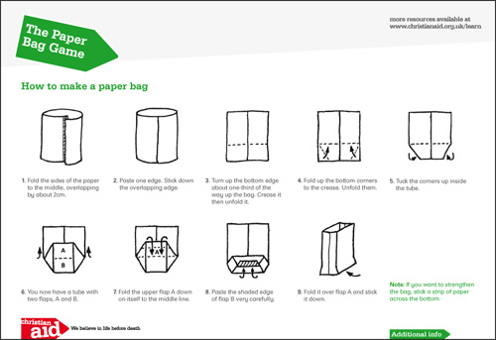

Slide 5
10 minutes per week

Slide 6
Plenary: thinking time!
Create a newspaper headline that answers this question= ‘What happens when India and China are fully developed?’

Slide 7
ALL: Students will know that not everyone gets treated fairly in the work place. (Level 3b-4a)
MOST: students will understand why some people are treated unfairly and will understand who is determines their treatment. (Level 4b-5a)
SOME: students will be able to explain why the world is dependent on countries where these conditions are allowed. (Level 5a-7a)

