Slide 1
Watch and listen: http://www.youtube.com/watch?v=SD7sZdAaS2M
Try and answer the following questions:
What are the people like in the advert?
What sort of life do they have?
What sort of feeling does the advert conjure up?
What is the advert saying?

Slide 2
Me and my mobile
L.O. To know what has changed in the way we shop.

Slide 3
ALL: Students will know that a mobile uses parts from different countries. (Level 3b-4a)
MOST: Students will understand that these countries are interdependent. (Level 4b-5a)
SOME: Students will understand the problems caused by the mobile industry. (Level 5a-7a)

Slide 4
Who makes the iPhone?
If you answered 'Apple', you're wrong. The iPhone is a global effort. Tens of thousands of people at more than 30 companies on 3 continents work together to make Apple's first phone possible.

Slide 5
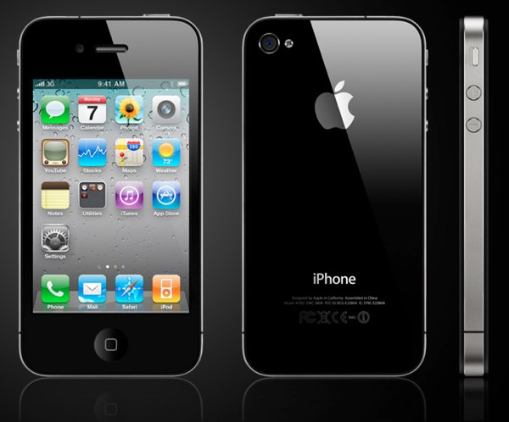

Slide 6
Item | Country who makes it:
Screen
Battery
Touch screen
Internal circuit
Chips
Steel case
Camera
Applications
Charger socket
iPhone 4 design
iPhone production

Slide 7
iPhone answers:
Item | Country who makes it:
Screen | Japan
Battery | DR Congo
Touch screen | Germany
Internal circuit | UK
Chips | China
Steel case | Taiwan
Camera | USA
Applications | World wide
Charger socket | South Africa
iPhone 4 design | UK
iPhone production | China

Slide 8
Get creative!!!!!
In pairs you are to create and advert that shows how connected countries are to make the iPhone.
You can perform it, create a storyboard, or any other way you can do it.
You have 20 minutes of next lesson to finish.

Slide 9
Peer assessment:
You need to judge each others’ work to see who is the winner!
They will go in a hat for a iPhone related prize!

Slide 10
Plenary: thinking time!
If China suddenly disappeared what would change in the global world?
Answer this question using as few words as possible.

