Slide 1
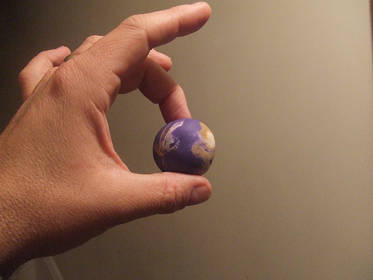
What does this show?

Slide 2
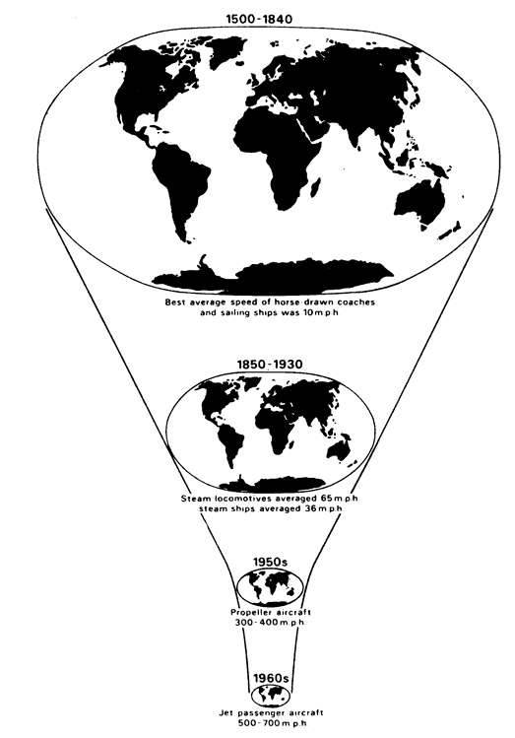
Does this help?

Slide 3
Virtual worlds
L.O. To know what has changed in the way we shop.

Slide 4
ALL: students will know that the way we shop has changed. (Level 3b-4a)
MOST: students will understand what the results of these changes are. (Level 4b-5a)
SOME: students will be able to explain the problems that these changes bring and think of possible solutions to these problems. (Level 5a-7a)

Slide 5
The internet what an invention!
List everything you use the internet for and any sites you specifically use. This could be anything from Facebook to i-tunes.
Try and explain why you use such sites.

Slide 6
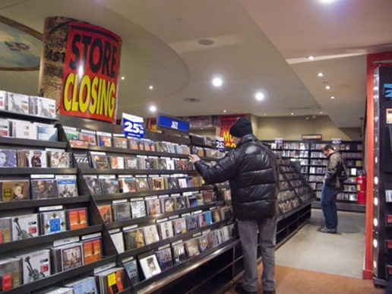
Why has Mayrama lost her job?
Sort the cards into different groups and work out why Mayrama lost her job. Be prepared to share ideas.
Why have people like Mayrama lost their jobs? What is the future?

Slide 7
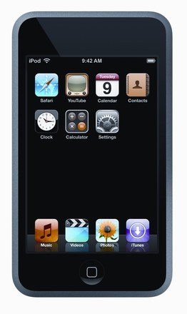
Plenary: text the teacher!
Write a text with a possible solution to the problem studied in today’s lesson.

Slide 8
ALL: students will know that the way we shop has changed. (Level 3b-4a)
MOST: students will understand what the results of these changes are. (Level 4b-5a)
SOME: students will be able to explain the problems that these changes bring and think of possible solutions to these problems. (Level 5a-7a)

