Slide 1
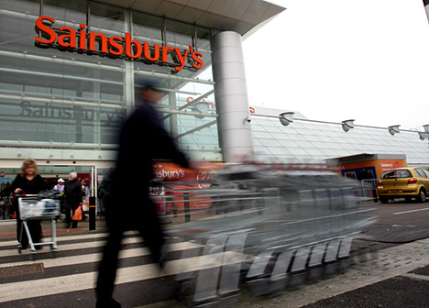
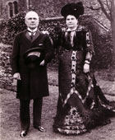
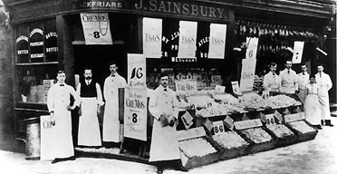
Who is this couple?
The couple who set up Sainsbury’s

Slide 2
Where do we go to buy our stuff?
L.O. To know what has happened in the retail industry.

Slide 3
ALL: Students will know that where we buy goods from has changed. (Level 3b-4a)
MOST: Students will understand how shopping patterns and products have changed. (Level 4b-5a)
SOME: Students will be able to explain why shopping patterns and products have changed and understand what impact this has on the retailer. (Level 5a-7a)

Slide 4
What do you know about Sainsbury’s?

Slide 5
History of Sainsbury’s
Read the information and sort it into chronological order.
What main changes did Sainsbury’s bring to shopping since opening?
Which change do you think is the most important, why?

Slide 6
What if they had
a profile?

Slide 7
Home
Profile
Inbox
Friends
Settings
Logout
Search
Q
Name
Last status update here
10hrs ago
Add a picture here
Wall
Info
Photos
Boxes
What would they be typing now?
Ads
What’s on your mind?
Share
View photos
View videos
What have they been doing on Facebook?
Recent Activity
Add personal information here
Information
Two interactions with friends
What ads would be targeted to them?
Who would they be friends with?
Groups
Friends
What groups are they in?
Older posts

Slide 8
Home
Profile
Inbox
Friends
Settings
Logout
Search
Q
Name
10hrs ago
Wall
Info
Photos
Boxes
What’s on your mind?
Ads
Share
View photos
View videos
Recent Activity
Information
Groups
Friends
Older posts

Slide 9
Plenary: Most likely to...
Which shop would you buy these from (and why)?
CD
Wii game
Apples
MP3 player
Ipod
Tin of beans

Slide 10
ALL: Students will know that where we buy goods from has changed. (Level 3b-4a)
MOST: Students will understand how shopping patterns and products have changed. (Level 4b-5a)
SOME: Students will be able to explain why shopping patterns and products have changed and understand what impact this has on the retailer. (Level 5a-7a)

