Slide 1
Is globalisation a good thing?
L.O To be able to develop ideas about globalisation.
Starter: Write a 30 second recap of what you have learnt so far.

Slide 2
ALL: Students will know what their target level is.
MOST: Students will know how they will reach their target level.
SOME: Students will develop ideas about how to increase their current levels.

Slide 3
Assessment time!
You are going to write a essay to answer this question “Should Globalisation be stopped?”
You can use the information sheet and your books to start planning your assessment.
You will have this lesson and next lesson to complete the essay, it cannot be taken home.

Slide 4
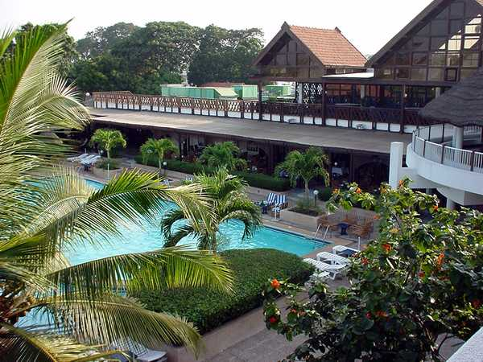
Connectives Card Game
One person takes a card from the pile. They must come up with a sentence about the picture using the explaining connective on the card. For example:
therefore
‘Hotels like this have wonderful facilities such as the swimming pool and therefore a holiday here would be very expensive’.

Slide 5
Why should Year 9 be given a day off?

Slide 6
Explaining Is Easy
Just build up your sentence like a jigsaw
Sentence starter
Connective word
Explanation

Slide 7
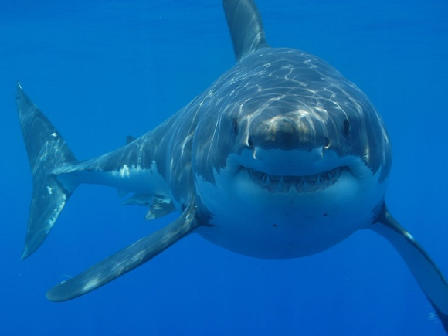
Example
That shark is massive
THEREFORE
we are going to need a bigger boat
Sentence starter
(a fact)
Key Connective
Explanation
The key connective you use decides what explanation you need

Slide 8
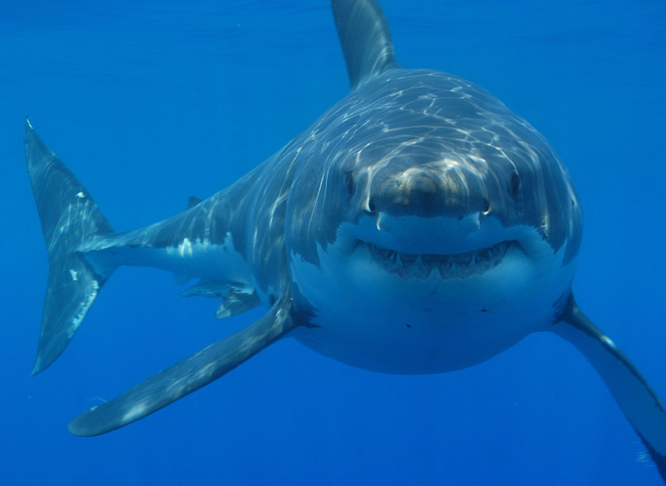
Example
That shark is very big
BECAUSE
it has eaten lots of sailors
Sentence starter
(a fact)
Key Connective
Explanation
The key connective you use decides what explanation you need

Slide 9
Now You Try
Sentence starters (Statement of a fact) | Key Connectives | Geography Words for your explanations (you can also use your own)
Globalisation is a problem… Globalisation helps people… LEDCs are unhappy… Apple have developed… | Because Therefore As a result So Due to Then Consequently | Development Economic impacts Sweatshops Fair Trade Equality Globalisation TNC Multinational Social impacts Sustainable Agroforestry Exploit

Slide 10
So what do you need to do?
The question is:
“Should Globalisation be stopped?”
So you need to write a balanced argument about Globalisation.
Start with an introduction about what Globalisation is and then try and say what the question is asking.
Use examples to show why Globalisation is good and why it is bad. (Remember the explaining connectives!)
Try and write about what the world will be like with and without Globalisation.
Finally you need to write about your own opinion, do you think it is good/bad. Try and give examples to back up your ideas.
Good luck!

Slide 11
Plenary: Splat!
Level 1 | Level 8 | Level 5 | Level 6
Level 3 | Level 2 | Level 3 | Level 4
Level 8 | Level 1 | Level 2 | Level 7
Level 7 | Level 4 | Level 5 | Level 6

Slide 12
ALL: Students will know what their target level is.
MOST: Students will know how they will reach their target level.
SOME: Students will develop ideas about how to increase their current levels.

